Slide 1




PISANG

Slide 2
WHAT IS DINARPAL
“ Islamic Integrated Financial Instruments (computerized system) allowing payments and money transfer to be made through online and it is pegged by physical gold and silver through Islamic Pawnbroking Process known as E-Rahnu. The value of the gold and silver are stored in The Islamic Digital Wallet as e-dinar and e-dirham “

Slide 3
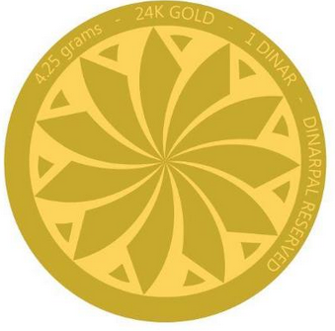
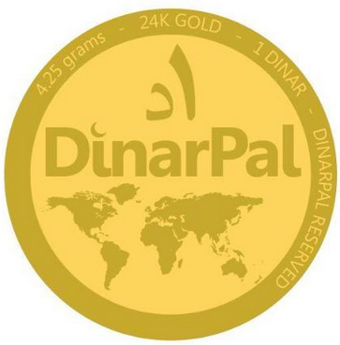
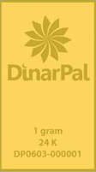
PRODUCT DESCRIPTION
Islamic Integrated Financial Instruments (Computerized Systems)
Physical Gold & Silver
Jewelry
Islamic Gold & Silver Trading
Islamic Digital Ar-Rahnu
Islamic Digital Money (E-Dinar & E-Dirham)
Islamic Digital Wallet
Islamic Digital Payment Gateway
Islamic Digital Mall
Islamic Gold & Silver Bar
Islamic Dinar & Dirham (coins)
Ring, Bracelet, Earring and etc

Slide 4
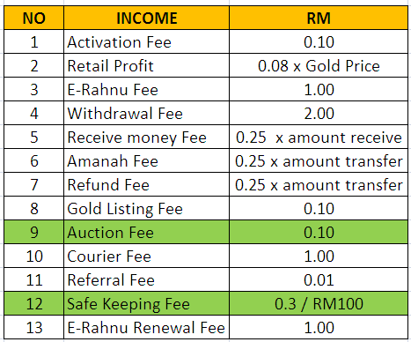
INCOME STREAMS

Slide 5
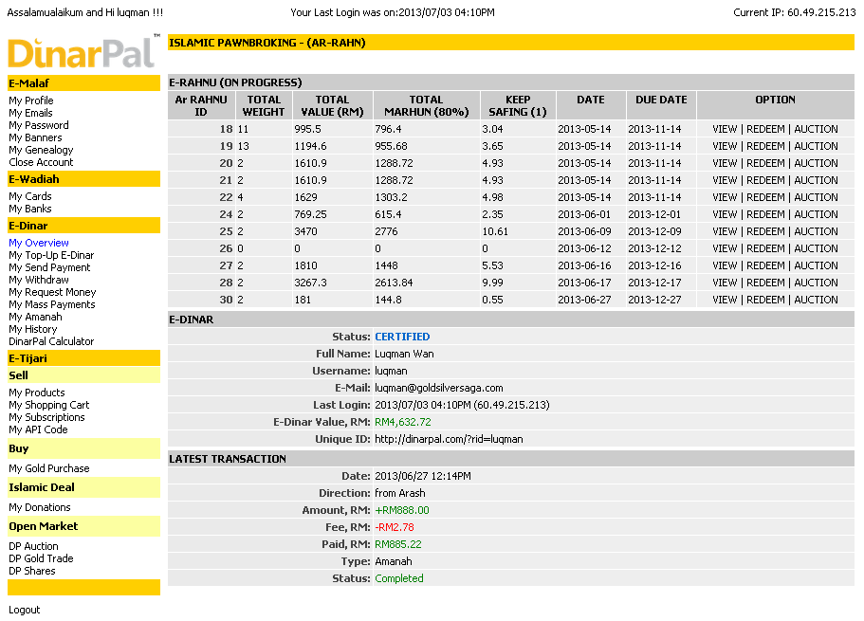
COMPUTERISED SYSTEM OVERVIEW
https://www.dinarpal.com

Slide 6
NOVELTY & INVENTIVENESS - NOVELTY
AR-RAHNU
E-RAHNU
E-WALLET
ISLAMIC
E-WALLET
E-PAYMENT
GATEWAY
ISLAMIC
PAYMENT
GATEWAY

Slide 7
NOVELTY & INVENTIVENESS - NOVELTY
Islamic Digital Money
Novelty
- Islamic Digital Money
- Islamic Digital Wallet
- Islamic Digital Pawnbroking (E-Rahnu)
- Islamic Digital Payment Gateway
- Islamic Digital Banking
- Islamic Halal Mall
E-RAHNU
ISLAMIC
E - WALLET
ISLAMIC
DIGITAL
PAYMENT
GATEWAY
Islamic E-Banking
Islamic Market Place

Slide 8
CREATIVITY (5 marks)
Islamic Digital Money
Our own module
E-RAHNU
ISLAMIC
E - WALLET
Our own scripts
ISLAMIC
DIGITAL
PAYMENT
GATEWAY
We Use FPX & MEPS
Our own module
Islamic E-Banking
Islamic Market Place
Patented

Slide 9

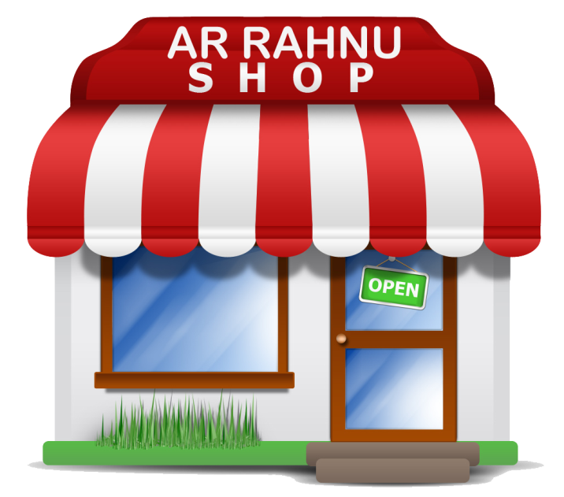
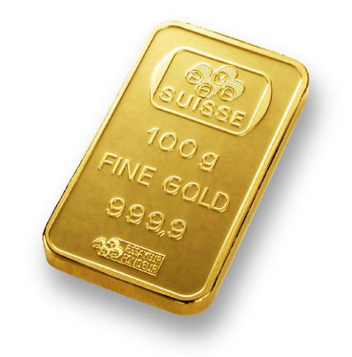
HOW IT WORKS

Slide 10

HOW IT WORKS

Slide 11


HOW IT WORKS

Slide 12


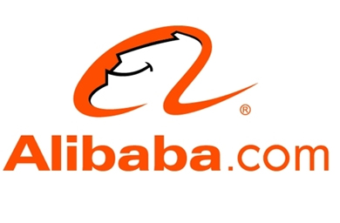

HOW IT WORKS
?

Slide 13
SCIENTIFIC RIGOR - QURAN & HADITH
“Abu Bakar ibn Abi Maryam reported that he heard the Messenger of Allah, may Allah bless him and grant him peace, say:
"A time is certainly coming over mankind in which there will be nothing [left] which will be of use save a dinar and a dirham.“
(The Musnad of Imam Ahmad ibn Hanbal)“
“To mankind the love of worldly appetites is painted in glowing colours: women and children, and heaped-up mounds of gold and silver, and horses with fine markings, and livestock and fertile farmland. All that is merely the enjoyment of the life of the dunya.The best homecoming is in the presence of Allah”
Sura Al Imran, 14.

Slide 14
SCIENTIFIC RIGOR - QURAN & HADITH
“Dinars and dirhams are explicitly sanctioned in the Qur’an by the following ayats: in sura al-Imran 74: ‘Among the People of the Book there are some who, if you entrust them with a pile of gold, will return it to you. But there are others among them who, if you entrust them with just a single dinar, will not return it to you, unless you stay standing over them.’ And in Sura Yusuf, 20: ‘They sold him for a pittance, a few dirhams, considering him to be of little worth.’
“Allah does not bless usury, and He causes charitable deeds to prosper, and Allah does not love any ungrateful sinner. ” Al-Baqarah, 2: 276

Slide 15
SCIENTIFIC RIGOR - QURAN & HADITH
“And their taking usury though indeed they were forbidden it and their devouring the property of people falsely, and We have prepared for the unbelievers from among them a painful chastisement. ”
(An-Nisa, 4: 161)
“ And whatever you lay out as usury, so that it may increase in the property of men, it shall not increase with Allah; and whatever you give in charity, desiring Allah's pleasure-- it is these (persons) that shall get manifold ”
(Ar-Rom, 30: 39)

Slide 16
PRACTICALITY
Easy to peg your fiat money to gold and silver and step ahead for Shariah currencies implementation (dinar & dirham / e-dinar & e-dirham) via online or walk-in
Easy to pay even for small fraction of dinar and dirham value.
Easy for shopping especially for visa and mastercard holder (debit cards)
Easy to withdraw and transfer fund all over the world
Easy to access and it is paperless

Slide 17
USEFULNESS
As wealth protector. Gold and silver is a precious metal and the value cannot be zero.
As inflation “shield”.
As Islamic Currencies – Pure money and no riba.
As medium to pay zakat and infaq
Easy to monitor and track the trend of personal or business transaction history.
As element for waqaf

Slide 18
STATUS OF INNOVATION – MARKET POTENTIAL
Fiat money users
Bank and financial house
Ar-Rahnu players
Online seller, buyer, merchant and traders
Cooperative body
3rd version of web based system – Ready for simulation.
Pre-commercialization stage.
Funders & Investors still open for JV
OIC penetration

Slide 19
STATUS OF INNOVATION
Pisang Sdn Bhd
Patent Holder
International
DinarPal Sdn Bhd
Koperasi DinarPal Melaka Berhad
Master Licensee
BNM
DinarPal Musyarakah Committee
(DinarPal Sdn Bhd + Bank Muamalat Venture Sdn Bhd)
YAPIEM
Tentera
Bank Rakyat
Agro Bank
POS
Bank Islam
Master License Fee – RM7 million (3 years)
Royalty – 6% x gross sales / month
Sub License – RM 5 million
In Sha Allah will launch on April 2014
Sub Licensee

Slide 20
STATUS OF INNOVATION – MUSYARAKAH ARRANGEMENT
PHASE 1
PHASE 2
NO | CRADLE SDN BHD | RM | MUAMALAT VENTURE SDN BHD | RM
1. | CAPEX, OPEX and ICT purposes on Pisang Sdn Bhd | 493,914 | CAPEX, OPEX and Ar-Rahnu purposes on DinarPal Sdn Bhd | 800,000
2. | Nil | 0 | Gold Purchase (17 kg) | 3,200,000
3. | Nil | 0 | Pawnbroking Rolling Capital | 240,000,000
 | TOTAL | 493,914 |  | 248,000,000
Project value = RM25,250,914

Slide 21
STATUS OF INNOVATION – INTELLECTUAL PROPERTY
Trademark – Yes
Copyright - Yes
Patent - Yes

Slide 22
PUBLICATION
Business Strategy Toward Wealth Creation – Journal and thesis publication
Date Publishes - 19 Jan 2011

Slide 23
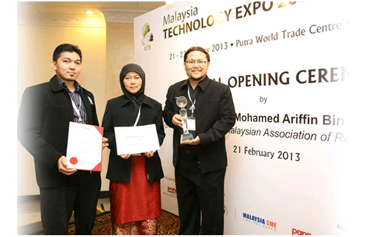
AWARDS & RECOGNITION
MALAYSIA TECHNOLOGY EXHIBITION 2013
The Very Best Award
Gold Medal
MDeC BUSINESS IDEA COMPETITION
Best Business Plan
NATIONAL INTELLECTUAL PROPERTY AWARD 2013
Merit
ASIA ICT AWARD
Represent Malaysia to Brunei

Slide 24

RECOGNITION & AWARDS
AGENSI INOVASI MALAYSIA – PRIME MINISTER OFFICE 2013
Wealth of Malaysia – Financial Services
Highest Bidders
ISLAMIC INNOVATION 2013
25-27 October 2013

Slide 25
CONTRIBUTION TO UMMAH – ISLAMIC CONCEPT
Solve the need toward Muamalah elements
Solve the need toward paying Zakat using dinar and dirham
Solve the need toward Waqaf and business Jihad
Solve the need toward avoiding usury (RIBA)
Solve the need toward avoiding Bank oppression
Solve the need toward money must be base on weight of gold and silver.

Slide 26
CONTRIBUTION TO UMMAH – SPESIFIC MUSLIM NEEDS
Solve the need toward Shariah Currencies (Dinar n Dirham)
Solve the need toward online Ar-Rahnu
Solve the need toward Islamic Digital Money
Solve the need toward Islamic Digital Wallet
Solve the need toward Islamic Digital Payment Gateway
Solve the need toward Islamic Digital Banking

Slide 27
CONTRIBUTION TO UMMAH – SIGNIFICANT CONTRIBUTION TO MUSLIMS
Contribution toward Shariah Currencies (Dinar n Dirham)
Contribution toward Muamalah
Contribution toward no more RIBA and GHARAAR
Contribution toward easy access to the system globally

Slide 28
CONTRIBUTION TO HUMANITY
Contribution toward halal and thoiyiba in economy culture
Islamic Banking and Muamalah is not for Muslims only but for mankind.
Contribution on avoiding for no more bank oppression on interest (RIBA)
Contribution on avoiding for no more money printed by public trustworthy bank and it must be PUBLIC BODY such as Baitul Mal.

Slide 29
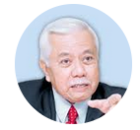

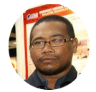

PISANG INC BACKGROUND & MANAGEMENT TEAM
Pisang Sdn Bhd (1045690 – A)
Incorporated on 10 May 2013
Suite 2 Level 2 MITC Melaka
CHAIRMAN
PRESIDENT
VICE PRESIDENTS
OPERATION
ARCHITECT
DIGITAL ARCHITECT

Slide 30




PISANG INC BACKGROUND & MANAGEMENT TEAM
VICE PRESIDENTS
MARKETING ARCHITECT
EXECUTIVE
EXECUTIVE
EXECUTIVE

Slide 31
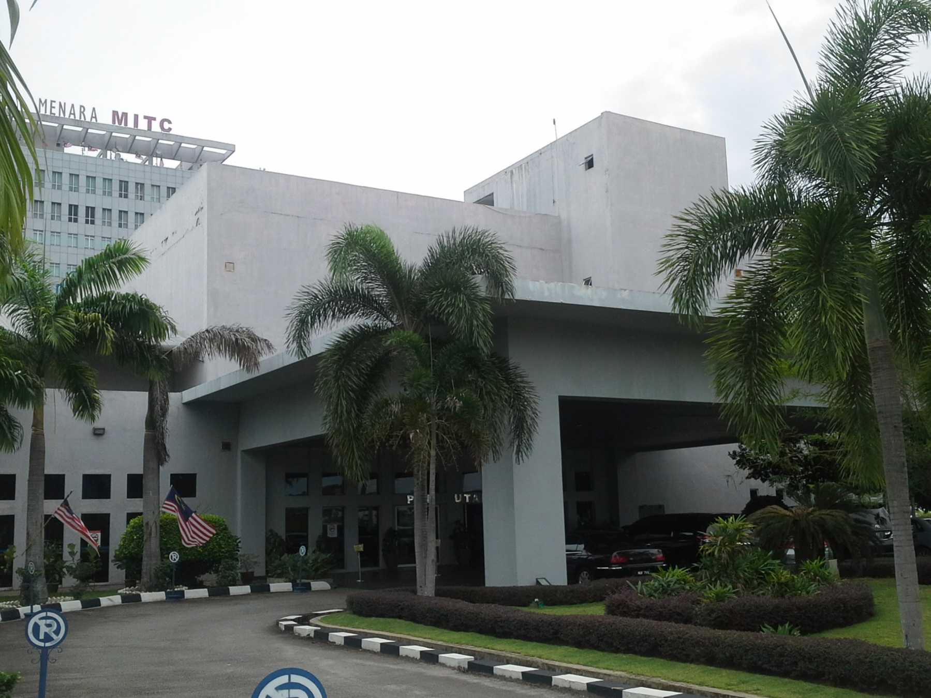
PROPOSED – DINARPAL OUTLET
DinarPal

Slide 32
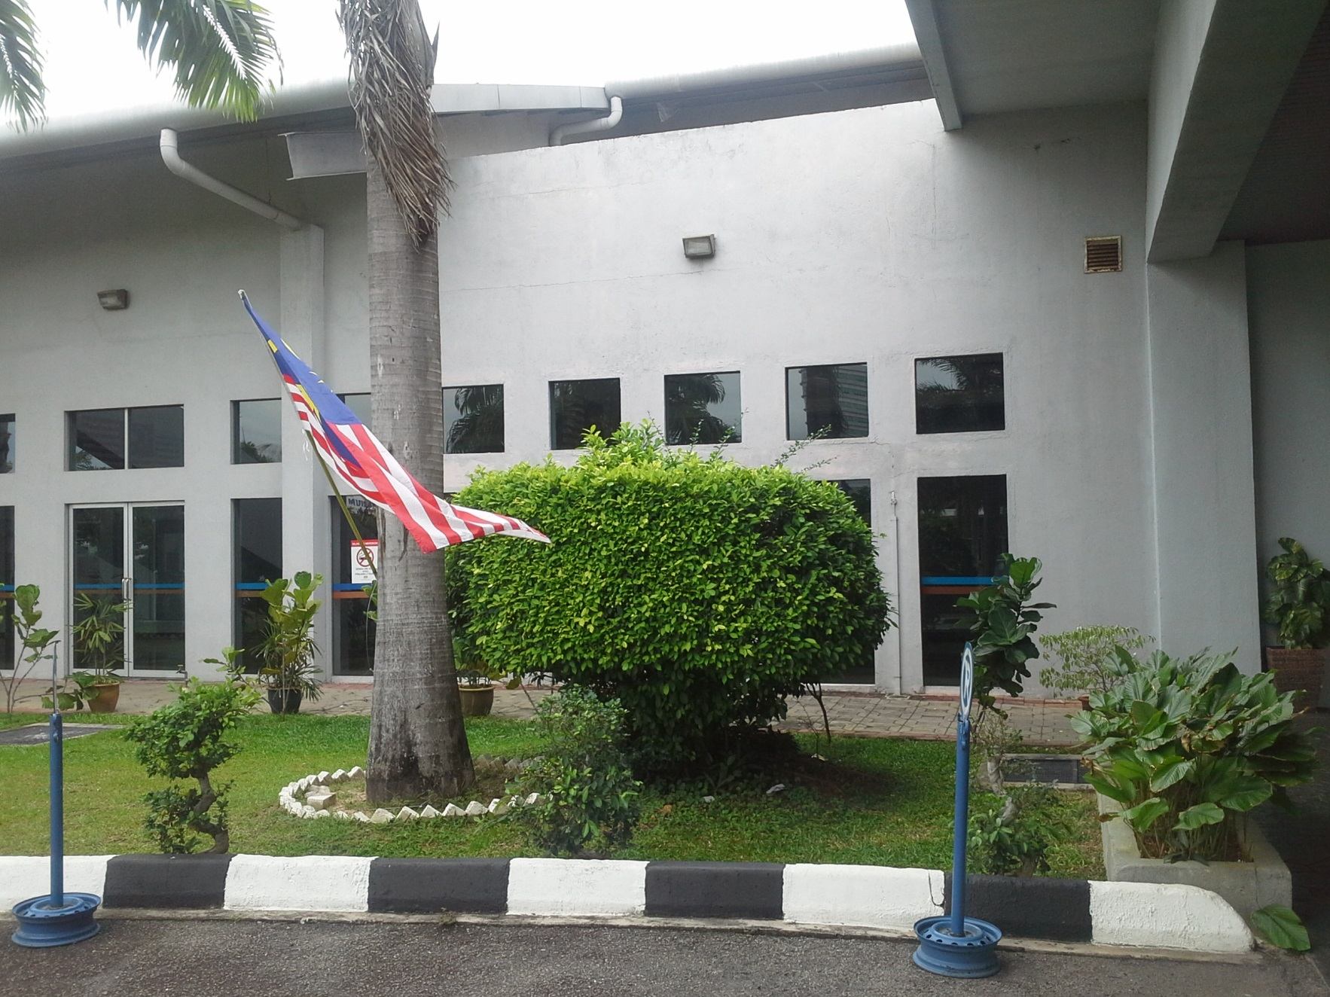
PROPOSED – DINARPAL OUTLET
D
n
a
r
i
P
a
l

Slide 33
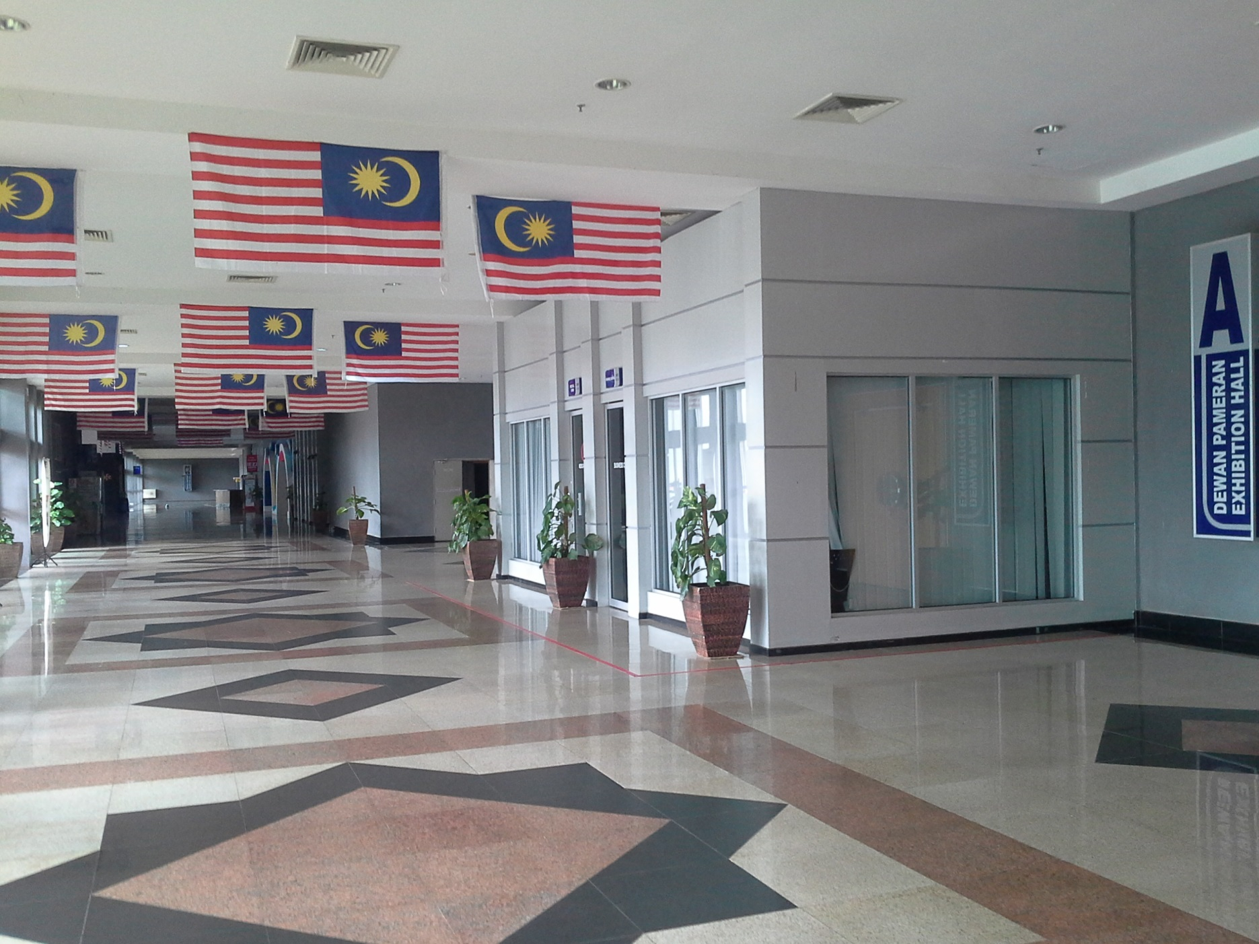
PROPOSED – DINARPAL OUTLET
DinarPal

Slide 34
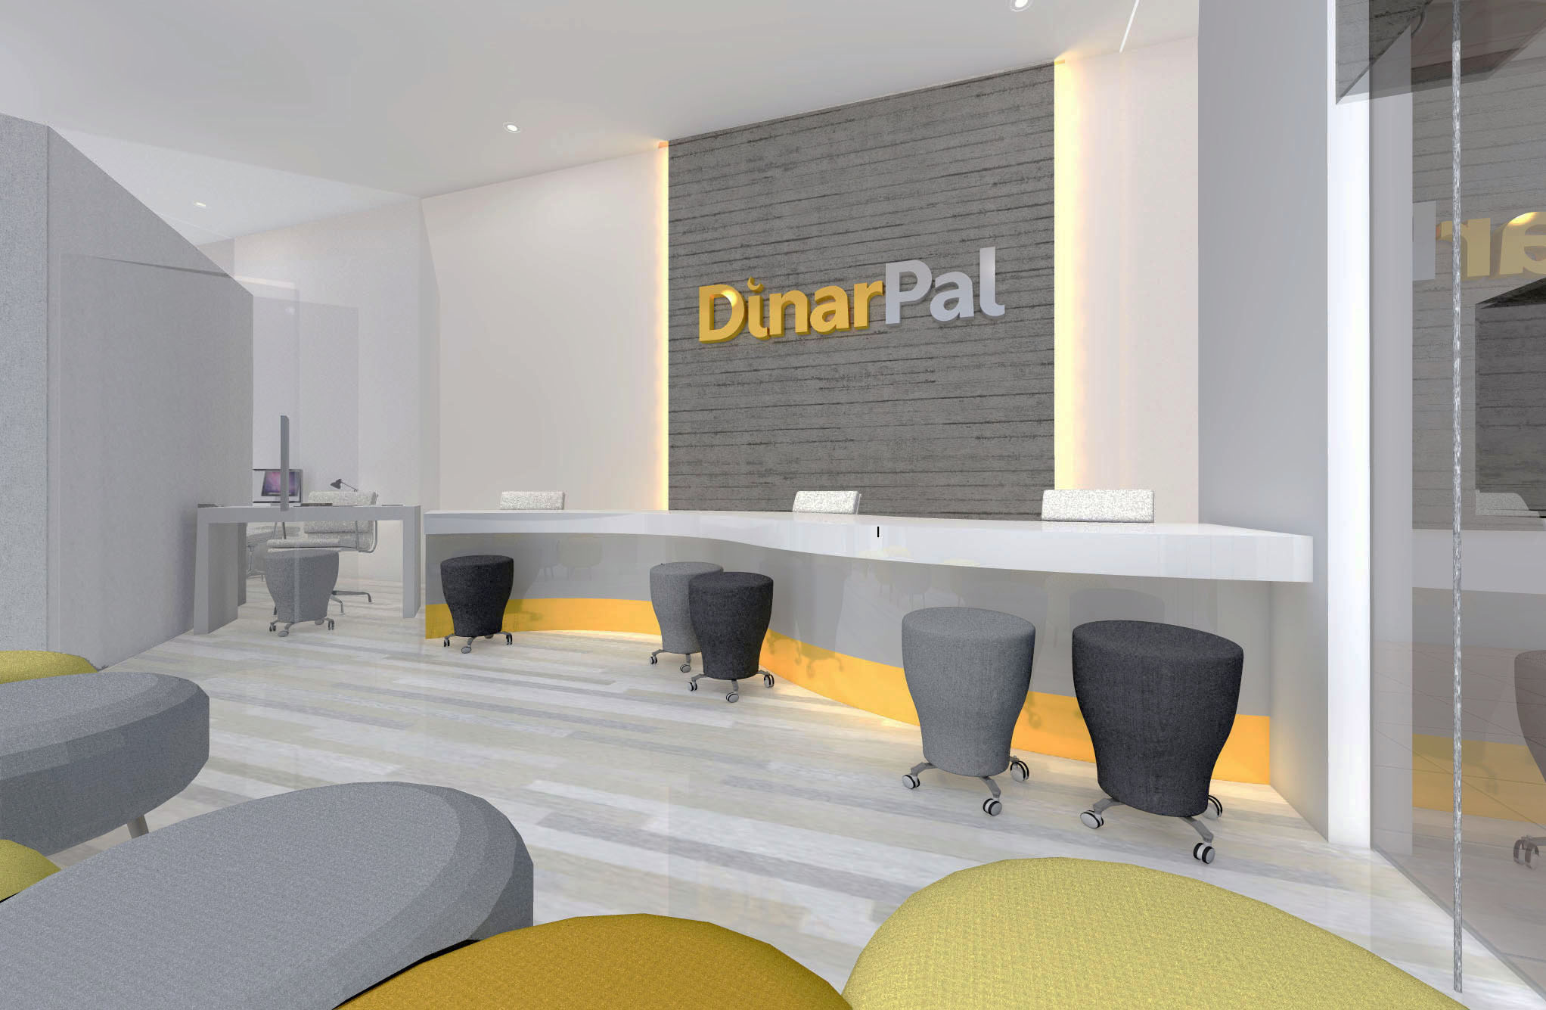
PROPOSED – DINARPAL OUTLET

Slide 35
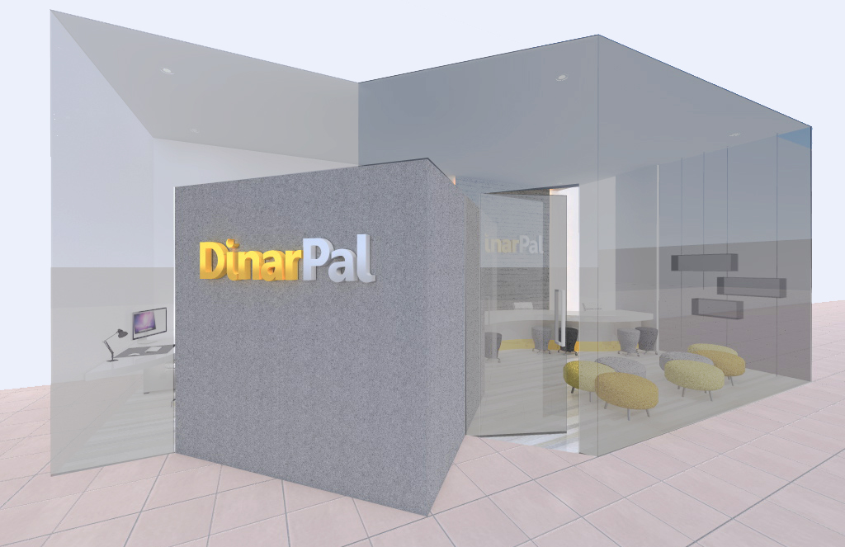
PROPOSED – DINARPAL OUTLET

Slide 36
PROPOSED – DINARPAL OUTLET

Slide 37
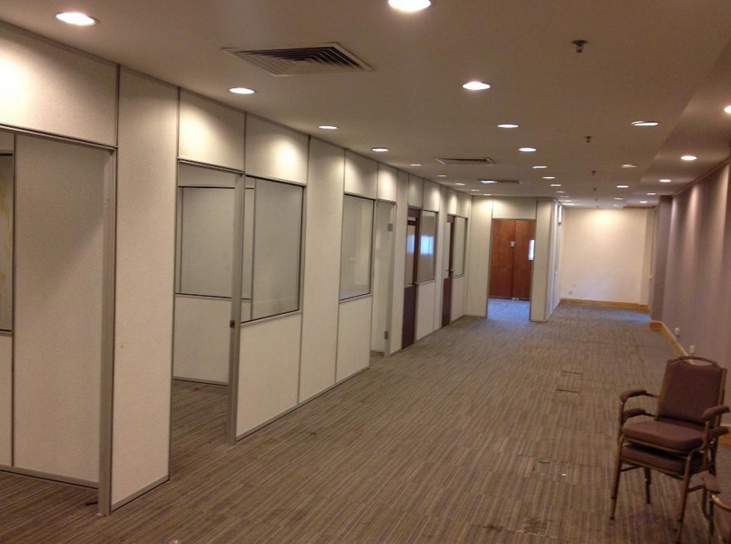
PROPOSED – MANAGEMENT OFFICE

Slide 38
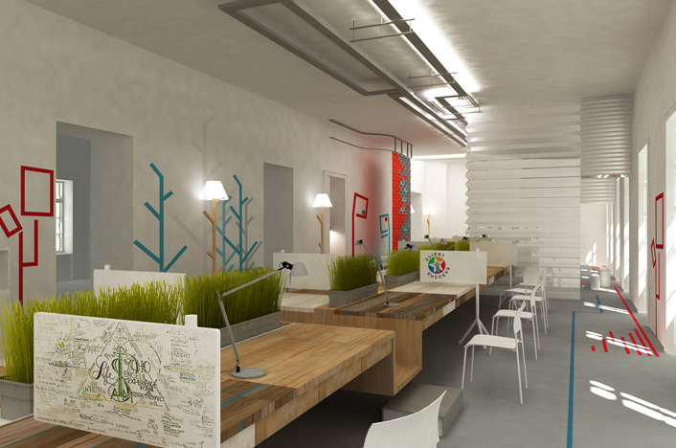
PROPOSED DESIGN OF MANAGEMENT OFFICE
DinarPal
DinarPal

Slide 39
INTELLECTUAL PROPERTIES
Patent – Worth RM25 million (reporting is on progress)
Licensing Fee – Worth RM7 million (verified by MOSTI)
Sub License– Worth RM5 million
Copyrighted
Trade Mark

Slide 40
CORPORATE ENVIRONMENT
Arash – 51%
Ridzuan – 34%
Wan Sazli – 15%
Pisang Sdn Bhd
Pisang – 51%
Tan Sri – 19%
Rahman, Sharipudin, Sahar – 30%
Tan Sri – Chairman
Secretary – Arash
Treasurer – Ridzuan
International
DinarPal Sdn Bhd
Tan Sri - Chairman
CSR – 60% + 40%
PSR – 60% + 40%
LSR – 60% + 40%
Royalty – 6%
Koperasi DinarPal Melaka Berhad
BNM
DinarPal Musyarakah Committee
(DinarPal Sdn Bhd + Bank Muamalat Venture Sdn Bhd)
YAPIEM
Tentera
Bank Rakyat
Agro Bank
POS
Bank Islam
Master License Fee – RM7 million (3 years)
Royalty – 6% x gross sales / month
Sub License – RM 5 million
In Sha Allah will launch on April 2014

Slide 41
UTILIZATION OF FUND – COMMERCIALIZATION FLOW
PHASE 1
PHASE 2
NO | CRADLE SDN BHD | RM | MUAMALAT VENTURE SDN BHD | RM
1. | CAPEX, OPEX and ICT purposes on Pisang Sdn Bhd | 493,914 | CAPEX, OPEX and Ar-Rahnu purposes on DinarPal Sdn Bhd | 800,000
2. | Nil | 0 | Gold Purchase (17 kg) | 3,200,000
3. | Nil | 0 | Pawnbroking Rolling Capital | 240,000,000
 | TOTAL | 493,914 |  | 248,000,000
Project value = RM25,250,914
No Equity involvement from Bank Muamalat

Slide 42
PRODUCT DESCRIPTION
Islamic Integrated Financial Instruments (Computerized Systems)
Physical Gold & Silver
Jewelry
Islamic Gold & Silver Trading
Islamic Digital Ar-Rahnu
Islamic Digital Money (E-Dinar & E-Dirham)
Islamic Digital Wallet
Islamic Digital Payment Gateway
Islamic Gold & Silver Bar
Islamic Dinar & Dirham (coins)
Ring, Bracelet, Earring and etc

Slide 43
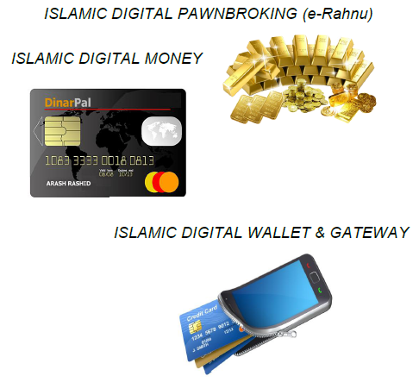
PRODUCT DESCRIPTION

Slide 44
COMPUTERISED SYSTEM OVERVIEW
https://www.dinarpal.com

Slide 45
VALUE PROPOSITION
Solve the need toward Shariah Currencies (Dinar n Dirham)
Solve the need toward avoiding usury
Solve the need toward low fee & charges
Solve the need toward resistance of the inflation
Solve the need toward stability of the currencies
Solve the need toward online Ar-Rahnu
Solve the need toward Islamic Digital Money
Solve the need toward Islamic Digital Wallet
Solve the need toward Islamic Digital Payment Gateway

Slide 46
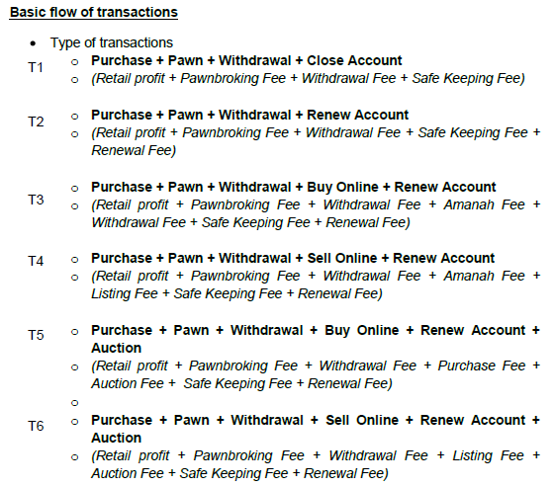
IMPACT – TRANSACTION TYPES

Slide 47
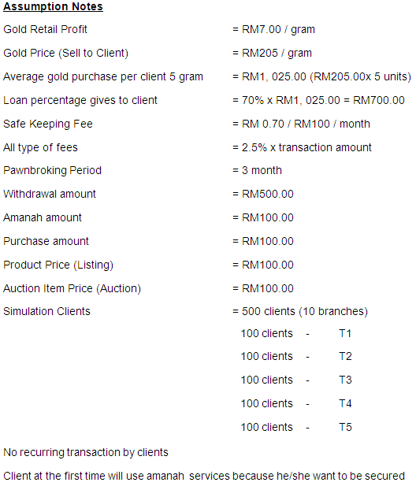
IMPACT – TRANSACTION TYPES

Slide 48
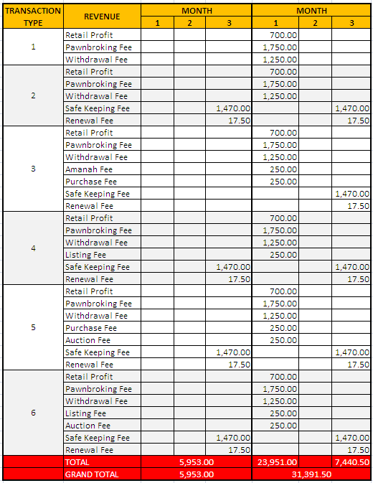
IMPACT
Immediate profit
5 - 6 times

Slide 49
MARKETING STRATEGIES
PHASE 1
PHASE 2
PHASE 3
Gold & Silver Trading Module
- Online ordering
- Online selling & buying
- Walk-in ordering
- Walk-in selling & buying
E-Rahnu Module
- Online pawnbroking
- Online auction
- Online fee paying
- Online redemption
Islamic Digital Money Module
- Sending and receiving money
- Request and amanah
- Refund
- Exchange
- Marketplace
- Item Listing
- Wakaf
Ready
Ar Rahnu License on progress
Suruhanjaya Koperasi Malaysia
E-Money Approval on progress
Bank Negara Malaysia
Duration to tee-off 2 month
Duration to tee-off 2 month

Slide 50




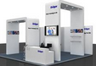



MARKETING STRATEGIES
PRICE
PLACE
ROMOTION
“Crazy” Price
- Skip workmanship fee
- Skip gold association fee
- Skip miscellaneous fee
- Lowest membership fee
Easy to access
- Walk-in to outlet
- Online outlet
- Mobile outlet
Unique package
- Referral commission
- Buy back guaranteed
- Special seasonal/festive event
THE PLATFORM
PRODUCT
Rare
- ½ dinar (gold coin)
- 1 dinar (gold coins)
- 0.5 gram gold bar
- 1 gram gold bar
- DInarPal Systems

Slide 51
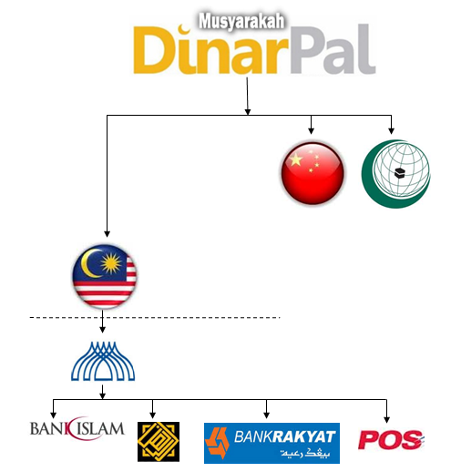
THE PROPOSAL
MASTER LICENSE IN MALAYSIA – RM7,000,000.00
SUB LICENSE – RM5,000,000.00
ROYALTI 6%

Slide 52
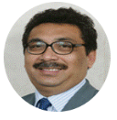
Q & A
This product (DinarPal) definitely worth billion! Hope it can be used sooner and give greater benefit to the people.
Government will give support to this innovative invention! Our nation always looking for any local company that can make use of technology and contribute to the worldwide, carrying Malaysia name.
http://www.pisang.my

